Slide 1


E.G.S Pillay Engineering College (Autonomous) Nagapattinam-611002.
DEPARTMENT OF ELECTRONICS AND COMMUNICATION ENGINEERING
Digital Menu System for Smart Food Ordering
in Restaurants
GUIDED BY, Dr. M. Irshad Ahamed(Convenor - R&D)
Associate Professor,
Department of ECE ,
E.G.S Pillay Engineering college, Nagapattinam.
PRESENTED BY,
PRAVEEN B (8208E22ECR075)
SUBASH M (8208E22ECR106) THARVESH MUHAIDEEN A (8208E22ECR113)

Slide 2
TABLE OF CONTENT
Abstract.
Introduction.
Objective.
Scope.
Literature Review.
Problem Identification.
Block Diagram For Proposed System.
Software.
Conclusion.
References.

Slide 3
ABSTRACT
The "Digital Menu System" is designed to make the ordering process easier for both customers and restaurant staff. Using an ESP32 microcontroller and an ESP01 access point, customers can connect to the system and view the menu on their devices. The menu shows images, names, prices, ratings, descriptions, and ingredients of each item. Customers can easily select and order items from their table.
The order is then saved as a JSON file and sent to the main server with details like the item name, quantity, and table number. The system is built using basic web technologies like HTML, CSS, and JavaScript, while Firebase is used to store and manage the orders in real-time. This project aims to improve the dining experience by making it faster and more convenient to place orders, while also reducing errors in communication.

Slide 4
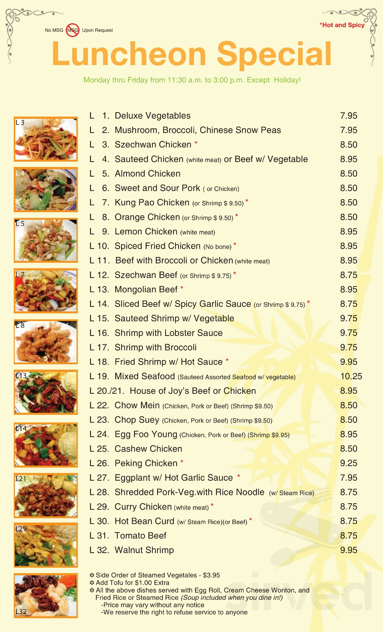
Problem Identification
→Problem Statement Traditional restaurant ordering often leads to miscommunication and delays, causing frustration for customers and staff. This inefficiency negatively impacts customer satisfaction and restaurant operations.

Slide 5
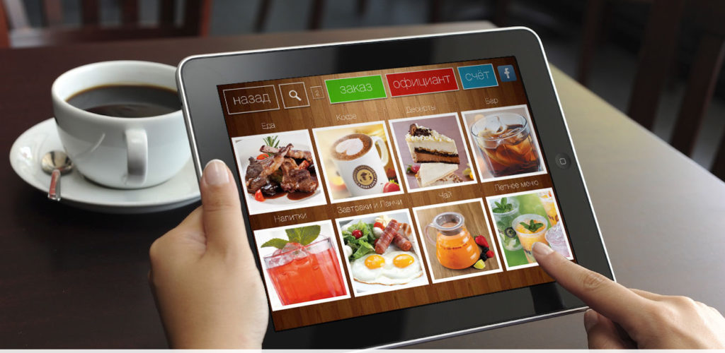
Problem Solution
→Proposed Solution The "Digital Menu System" provides a user-friendly digital ordering platform. Customers can connect their devices to view an interactive menu and place orders directly from their tables. Orders are sent straight to mgmt devices, ensuring accuracy and efficiency. Utilizing real-time data management through Firebase, this system enhances the dining experience and streamlines restaurant operations.

Slide 6
INTRODUCTION
The "Digital Menu System" project aims to create a user-friendly solution designed to enhance the ordering experience for both customers and restaurant staff. This innovative system leverages an ESP32 microcontroller and an ESP01 access point, enabling customers to connect their devices to the restaurant's network with ease. Once connected, customers can browse a digital menu that displays images, names, prices, ratings, descriptions, and ingredients for each menu item.
This system allows customers to select and order their food directly from their tables, streamlining the process and making dining more convenient. When an order is placed, it is saved as a JSON file and sent directly to the mgmt device, containing essential information such as the item name, quantity, and table number. Built using fundamental web technologies like HTML, CSS, and JavaScript, the system also utilizes Firebase for real-time order management.

Slide 7
OBJECTIVES
Make Ordering Faster: Simplify the ordering process to reduce wait times for customers and staff.
Enhance User Experience: Provide an easy-to-use interface for customers to view and select menu items on their devices.
Improve Order Accuracy: Reduce mistakes by sending orders directly from the customer’s device to the waiter’s mobile device.
Use Real-Time Data: Utilize Firebase to manage and store orders instantly for quick updates.
Display Menu Information: Show clear details for each menu item, including images, descriptions, ingredients, and prices.
Ensure Accessibility: Create an ordering system that is easy for everyone to use, including those with communication challenges.

Slide 8
SCOPE
To create a digital ordering platform for restaurants. It will enable customers to connect their devices and view an interactive menu with detailed dish information.
The system will streamline the order placement process, ensuring accurate transmission of orders to staff. By using Firebase for real-time data management, it will enhance efficiency and accessibility in the dining experience. The project will also be designed to be scalable, allowing adaptation for different restaurant settings.

Slide 9
LITERATURE REVIEW
Paper Title | Year | Author(s) | Abstract | Proposal for Research
Digital Ordering Systems: Enhancing Customer Experience | 2020 | Smith, J. | This paper explores the impact of digital ordering systems on customer satisfaction and operational efficiency in restaurants. | Investigate user preferences and feedback on digital menu systems.
Real-Time Data Management in Restaurants | 2019 | Johnson, L. | This study examines the role of real-time data management in restaurant operations, focusing on order accuracy and speed. | Propose a framework for integrating real-time data with customer interfaces.
The Effect of Interactive Menus on Dining Choices | 2021 | Chen, A. | This research analyzes how interactive digital menus influence customer choices and increase sales in restaurants. | Study the correlation between menu interactivity and order volume.
User-Centered Design in Restaurant Technology | 2022 | Martinez, R. | This paper highlights the importance of user-centered design in creating effective restaurant technology solutions. | Develop guidelines for designing user-friendly digital menus.
Addressing Communication Barriers in Dining Environments | 2023 | Patel, S. | This research focuses on communication challenges in restaurants and how technology can bridge these gaps. | Explore technology solutions that enhance communication in restaurants.

Slide 10

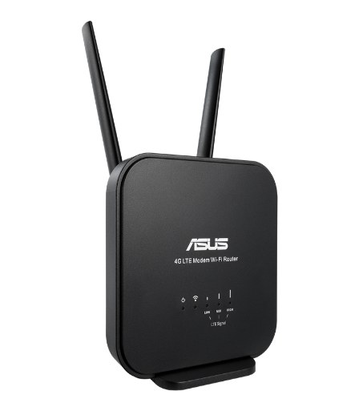
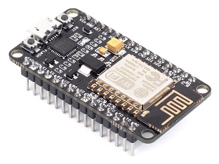
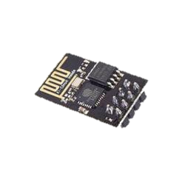
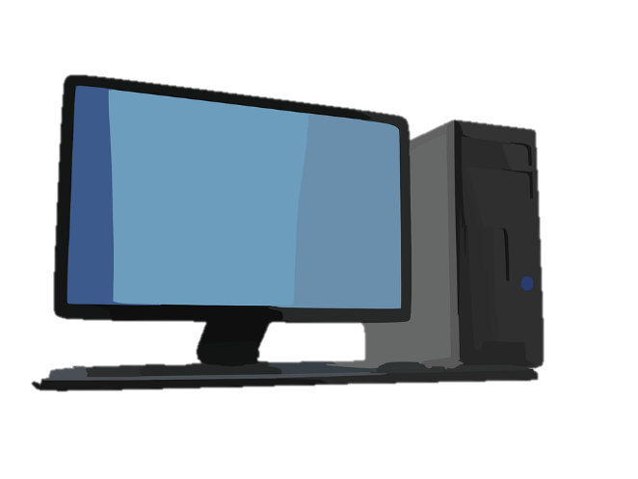
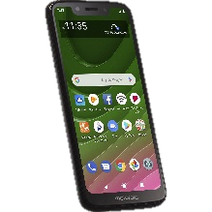
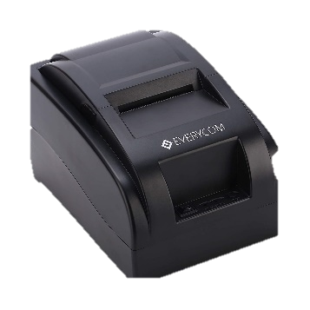
BLOCK DIAGRAM FOR PROPOSED SYSTEM
Web - Server
Restaurant System
Access Point
Restaurant Router
Customers
Billing Machine

Slide 11
Execution flow
1. Customer connects to ESP32 Access Point
2. Menu is displayed on a TFT screen(mobile phone)
3. Customer selects items and places orders
4. Order details are recorded and displayed to the waiter
5. Orders are updated in real-time.

Slide 12
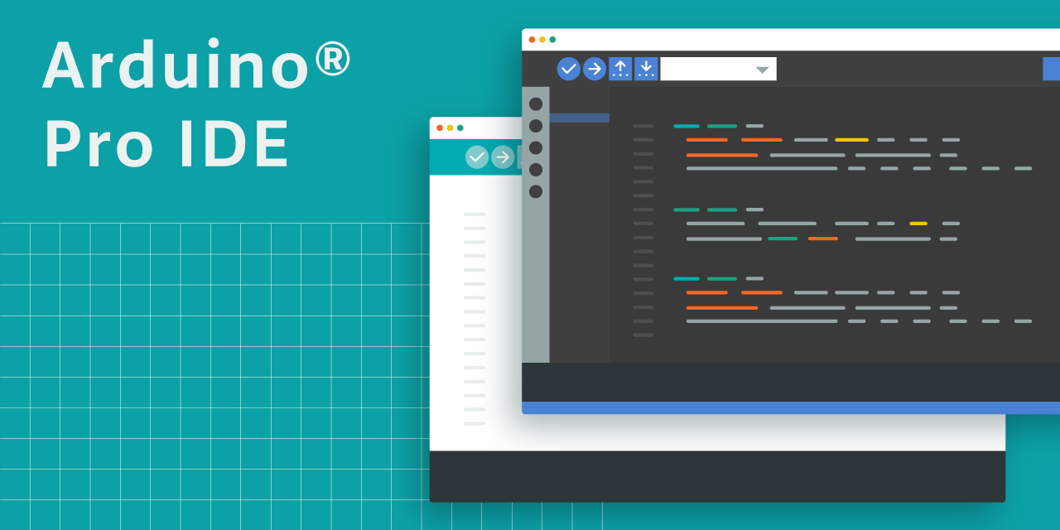

SOFTWARE TOOL
Arduino IDE (Integrated Development Environment)
VS Code

Slide 13
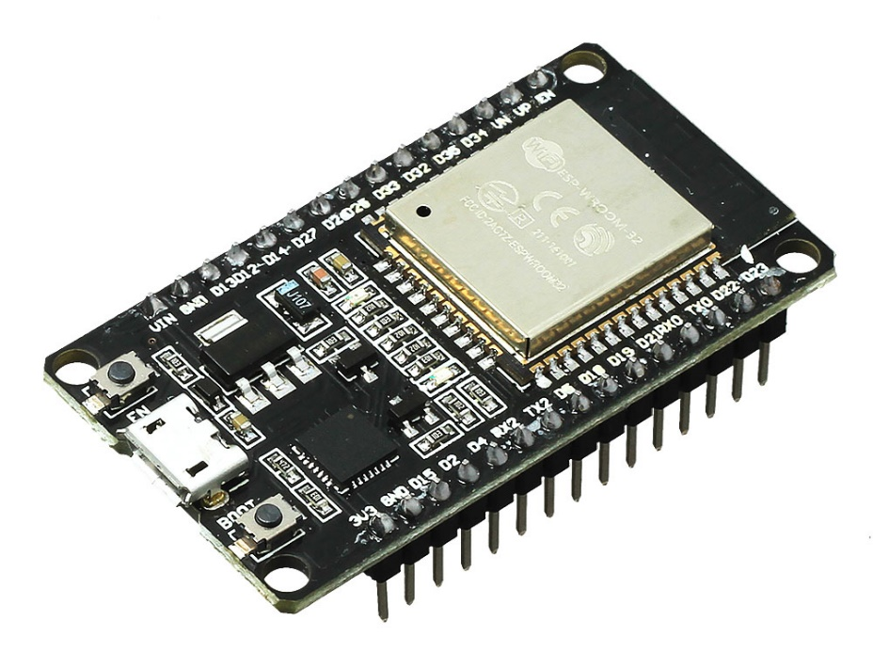
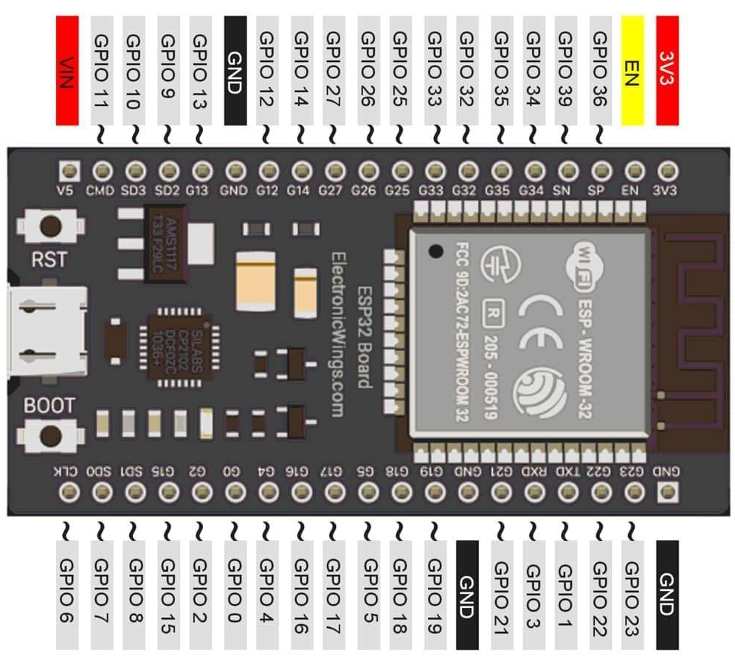
ESP32 - As server
HARDWARE TOOL
An ESP32 can be configured to act as a web server that handles requests from devices on the same network. The web server can serve web pages to users, and users can access the information stored on the ESP32

Slide 14
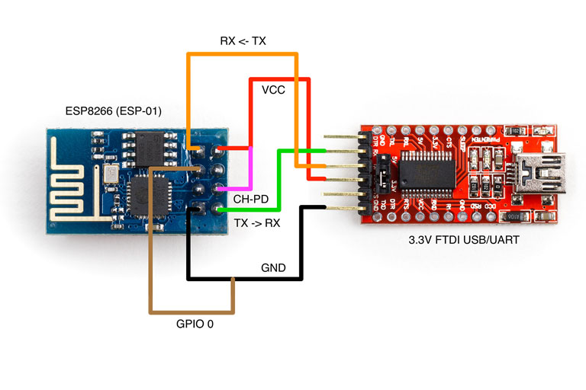
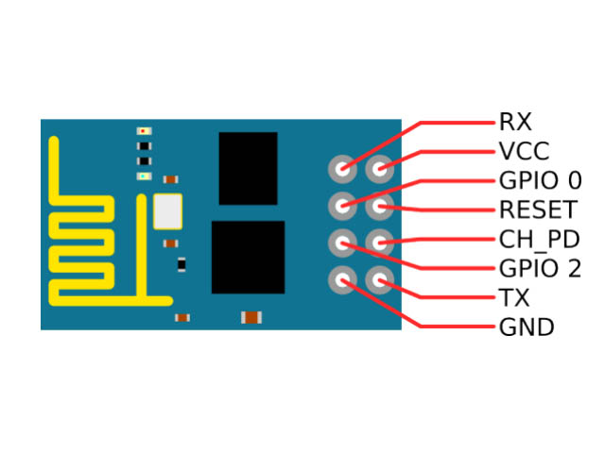
HARDWARE TOOL
ESP01 - As Access Point
The ESP8266 ESP-01 can also operate in other modes, including STA mode, which allows it to connect to an existing Wi-Fi network, and a mode that allows it to act as both an AP and a STA.
The ESP8266 ESP-01 is a self-contained System On a Chip (SOC) that can be programmed to work on its own or with a microcontroller.
This Photo by Unknown Author is licensed under CC BY-SA

Slide 15
1. Add Payment Options Let customers pay for their meals through the app after placing an order. This would make the whole process faster and more convenient, reducing wait times and improving the overall experience for both customers and staff. 2. Enhanced Security Features As digital systems handle sensitive customer and order information, future developments could focus on enhancing security measures such as encryption, secure authentication, and compliance with data protection standards to protect against cyber threats. 3. Track Ingredients in Real-Time Connect the system to track ingredient availability in real time. This way, the restaurant knows when something is running low, and customers won’t be able to order items that are out of stock. It makes operations smoother and helps reduce waste.
FUTURE SCOPE

Slide 16
CONCLUSION
The main objective of this paper is explained breifly that simplifies the ordering process, making it easier for customers and restaurant staff. By using modern technologies, it improves efficiency, reduces errors, and enhances the dining experience. With future improvements like payment integration and smart features, it can become an even more powerful tool for restaurants.

Slide 17
REFERENCES
Zhou, W., & Hsiao, S. (2018). "Design and Implementation of a Smart Ordering System Based on IoT."
Lee, J., & Shin, D. (2019). "The Development of a Digital Restaurant Menu System Using Embedded Devices." .
Kang, S., & Park, H. (2020). "A Study on the Application of Web Technologies in Restaurant Digital Menu Systems."
Chen, Y., & Liu, F. (2021). "Real-time Order Management System for Restaurants Using Firebase.”
Martinez, P., & Gomez, R. (2022). "Enhancing Customer Experience Through Digital Menu Systems and AI-based Recommendations."

Slide 18
THANK YOU

